Slide 1
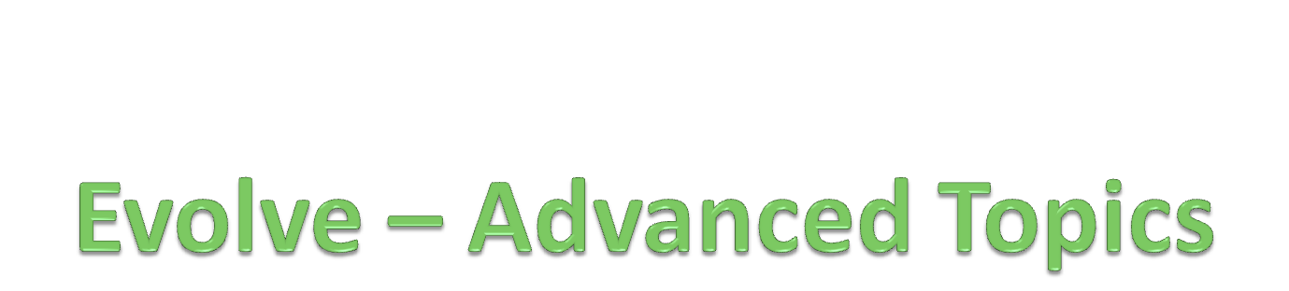
Andrew McVeigh
Jeff Magee
Jeff Kramer
Imperial College, London
Feb 2010

Slide 2
Contents
Brief overview of the formal model structures
Advanced extensibility features
  Port type inference
  Hyperports, factories, state machines
The Evolve toolset
Future work
Notes:
Strata are about packaging, and also controlling visibility

Slide 3
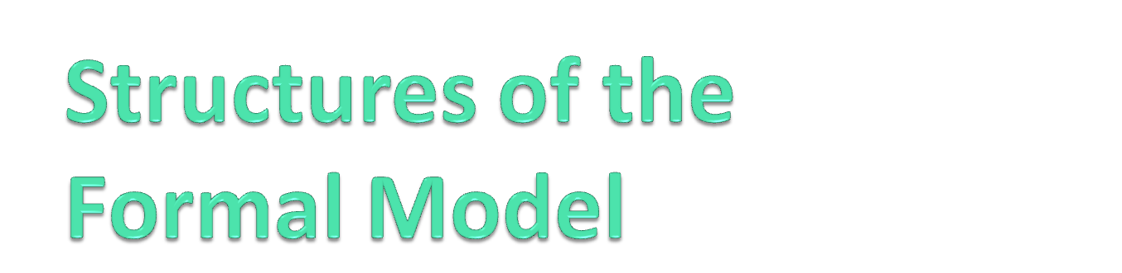
Notes:
Time only allows model structures to be discussed in overview – the core is how strata, resemblance and replacement interact.
Forming an expanded resemblance graph per stratum, for each element

Slide 4
Structure
Model is described in the Alloy logic language [Jac02]
Built up in layers
Structural rules
Components & interfaces
Stratum, resemblance, replacement, deltas
Notes:
Core ideas are the interplay between resemblance and replacement in a resemblance graph.
Expanded resemblance graph is formed for each stratum perspective, using strata dependencies to order.
Component design is one application of these concepts.
NB: layers in code are identical to layers in formal model – we expanded resemblance and replacement for each stratum perspective and then apply deltas. Then, the rules preventing bad composition pick up any changes from perspective of each stratum

Slide 5
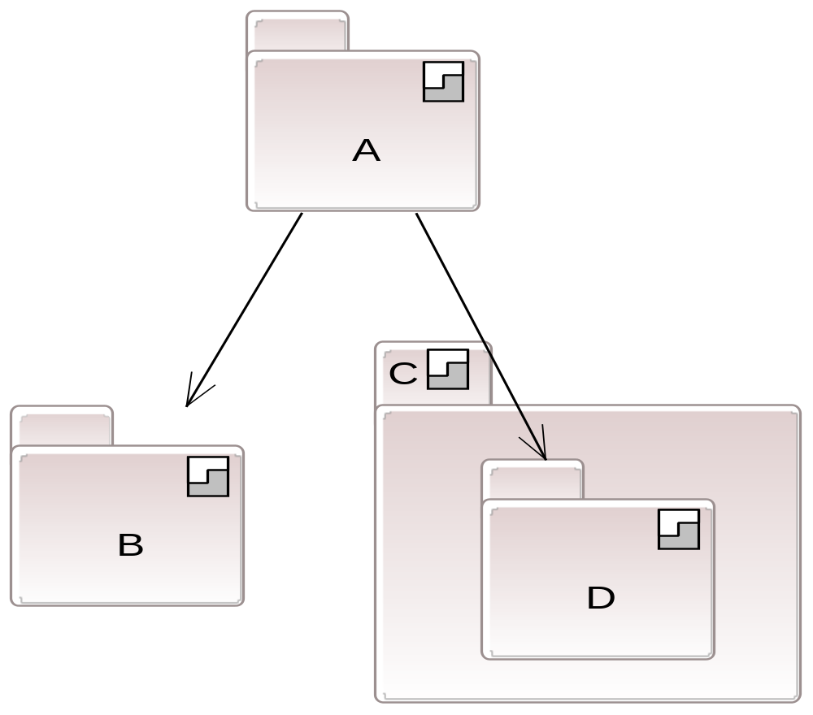
Strata
sig Stratum
{
dependsOn: set Stratum,
nestedStrata: set Stratum,
exportsStrata: set Stratum,
ownedElements: set Element,
...
Notes:
Note hierarchical nesting.
Explain module hiding behaviour:
Can export nested strata which makes them visible to your dependents.
-Alternatively, we can “reach in” and depend directly on a stratum – preserves intent of hiding but allows us to bypass it.
-Removes some tension between extensibility and hiding – e.g. OSGi “requirement-bundle” option to auto-export all packages, bypassing hiding in eclipse.

Slide 6
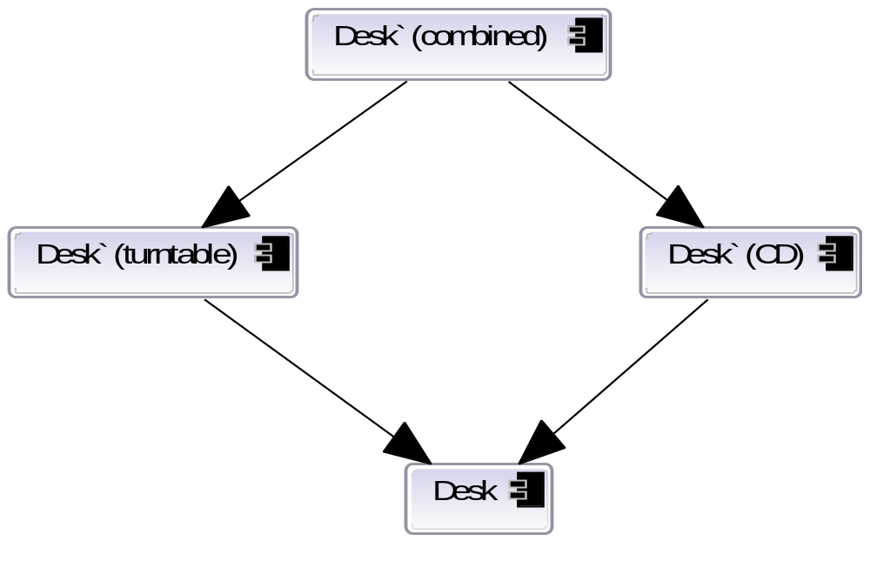
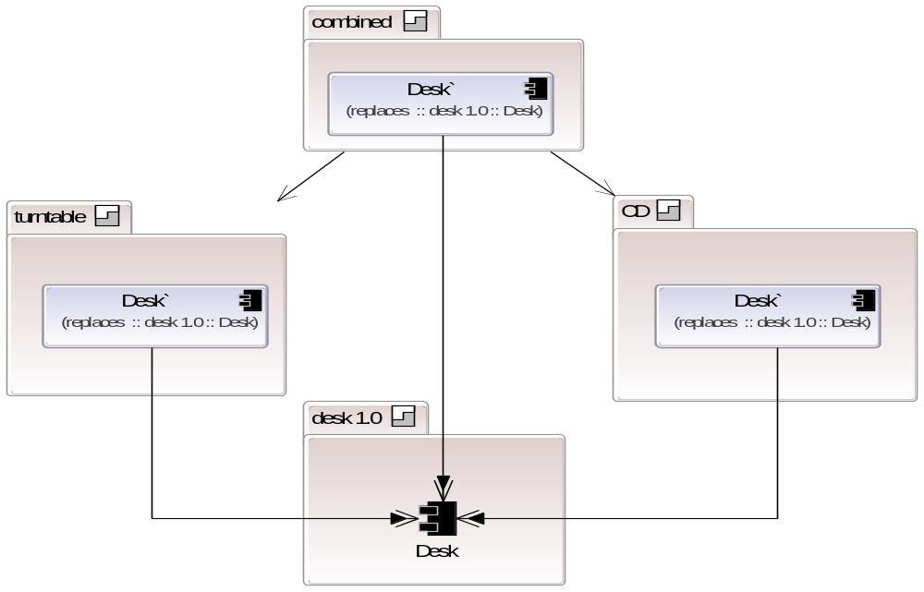
Elements and Resemblance
abstract sig Element
{
home: Stratum,
replaces: lone Element,
resembles: set Element,
resembles_e: Element -> Stratum,
...
Notes:
Concrete elements have

Slide 7
Components & Interfaces
sig Component extends Element {
parts: lone Parts/Deltas,
ports: lone Ports/Deltas,
connectors: lone Connectors/Deltas,
attributes: lone Attributes/Deltas,
implementation: lone Implementation/Deltas,
...
sig Interface extends Element {
operations: lone Operations/Deltas,
implementation: lone Implementation/Deltas,
...
Notes:
We apply this to the ADL...
Components are made up of ports, parts etc.
Interfaces are made up of operations – removal or replacement breaks subtyping

Slide 8
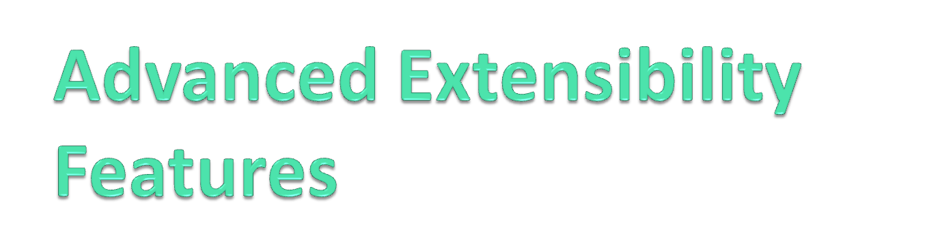
Port type inference
Hyperports
Factories
State Machines

Slide 9
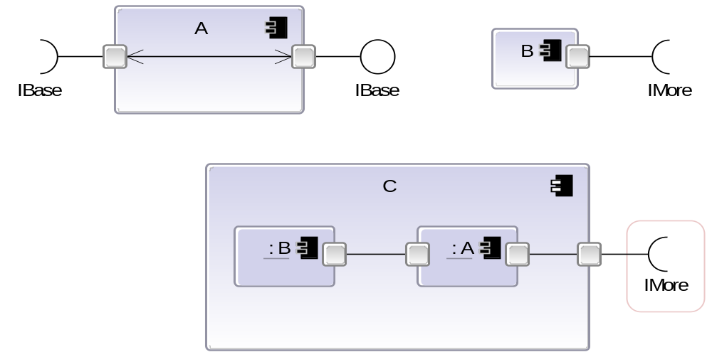
Inferring port types
Ports of composites have their interfaces inferred
  Propagates local changes globally without further deltas
  Exposes interfaces on one port back to “surface”
Notes:
We do it because it allows a local change to propagate globally automatically, without further deltas.
Mention about links summarising internal connections of leaves
Allows complex frameworks to accept a provided interface on one port, and propagate this to the another port

Slide 10
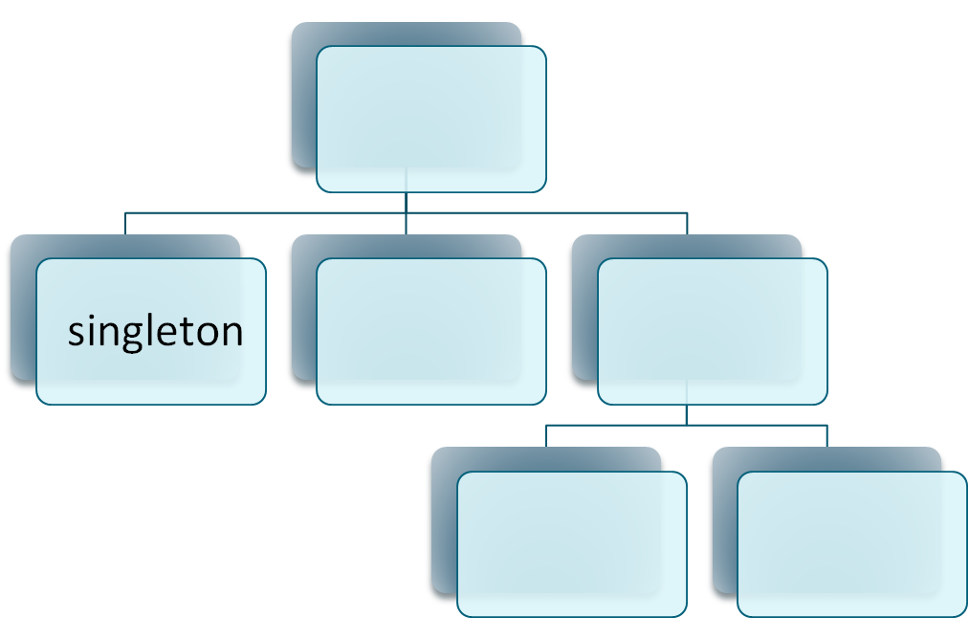
Cutting through the hierarchy
Hyperports are auto-connected down the hierarchy
More flexible & general singleton approach [Rum96]
Notes:
No limitations of conventional singletons
Can have more than 1
Covers a well defined portion of the hierarchy
Can override with manual connectors

Slide 11
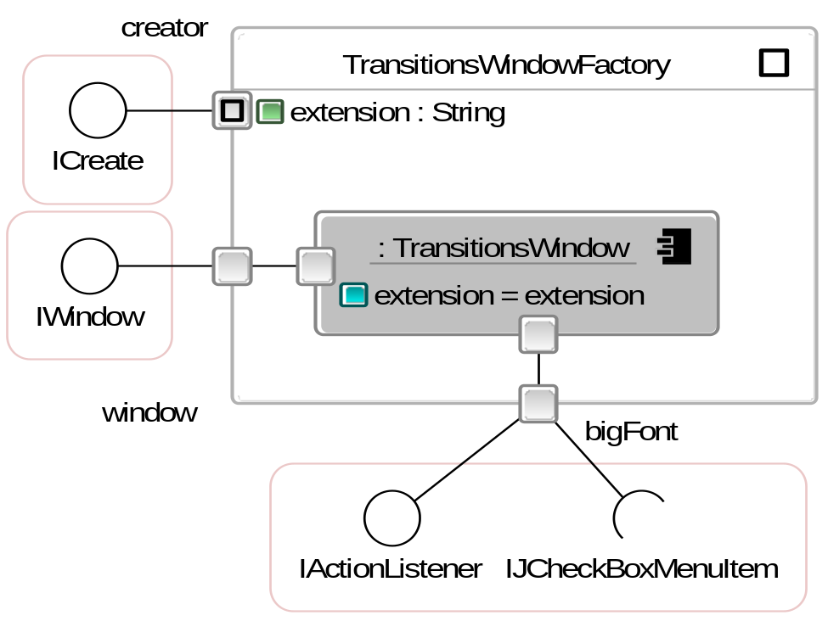
Isomorphic factories
Components with lazily instantiated insides [MDEK95]
  Use with resemblance and evolution
  Can be nested arbitrarily

Slide 12
Executable state machines
Component variant of state pattern
  Big switch component
  Use with resemblance and evolution
  Combine with conventional components
Advantages over OO approach
  Don’t get me started!
  Explicit transitions
  Extensible for states and transitions
  Rich context available for each state

Slide 13
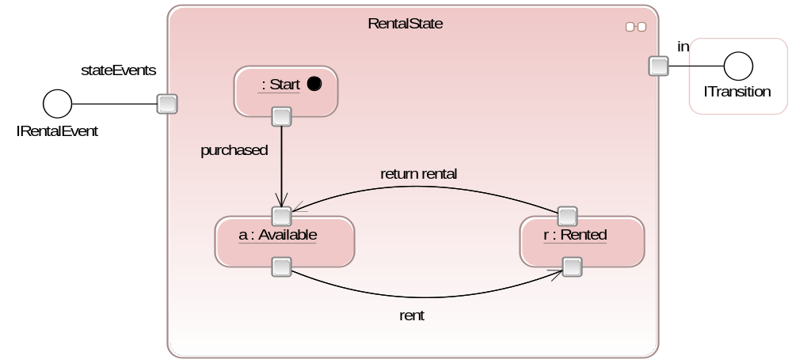
Executable state machines (2)
Notes:
NOTE: these are executable, like rest of Backbone
Context is much less constrained than in OO
Point out explicit transitions
Explain how resemblance and replacement can remake these
Provides far nicer way to handle common state patterns than OO variant

Slide 14

(+ current focus on Java)
Notes:
Designed to work in multiple ways – top-down or bottom-up

Slide 15
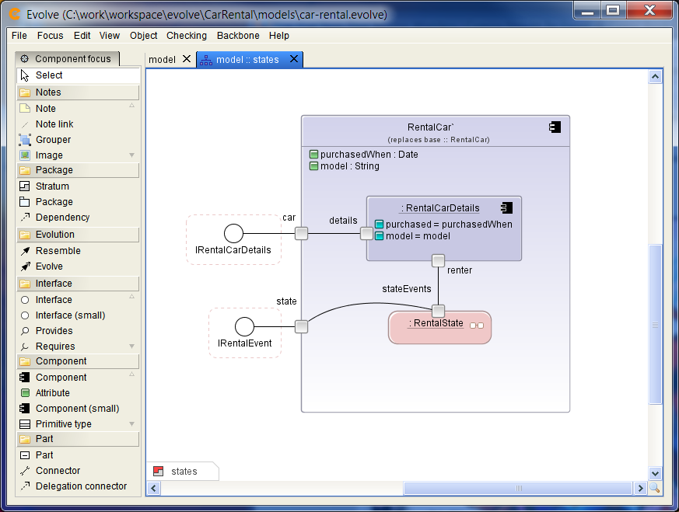
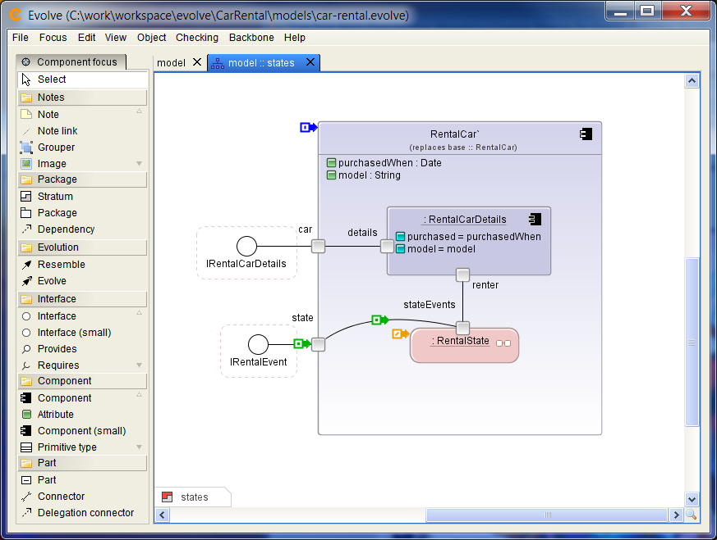

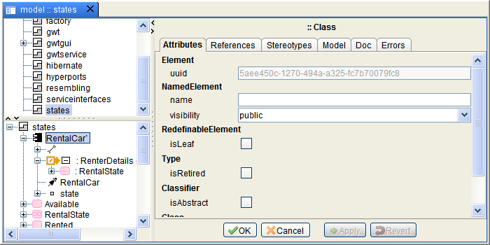
Notes:
Multiple diagrams
Multiple views of the same diagram
Full undo/redo
Diagrams always work with expanded structure, but record deltas
Can delete deltas from the browser

Slide 16
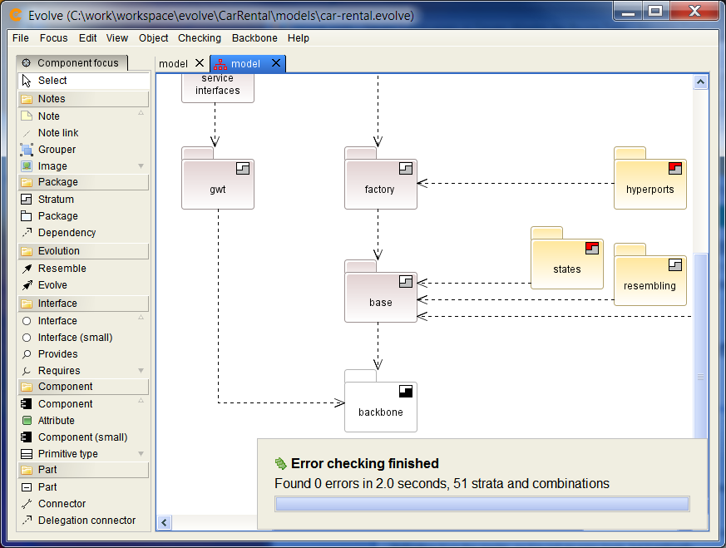
Diagrams versus underlying models
Notes:
Checking combinations
– number of combinations depends on replacements / destructive strata

Slide 17
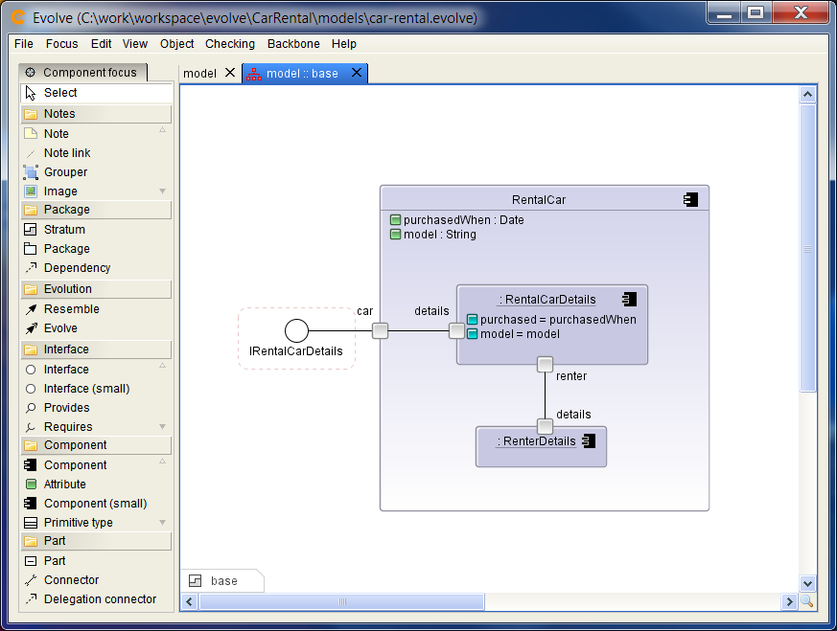
Code generation
Lossless forward generation
  Create bean setters and getters (ports too)
Reverse generation
  Import beans as full components
None of this is mandatory ;-)
Bean.java
Beans.jar
Notes:
These options are just here to help create the code faster.

Slide 18
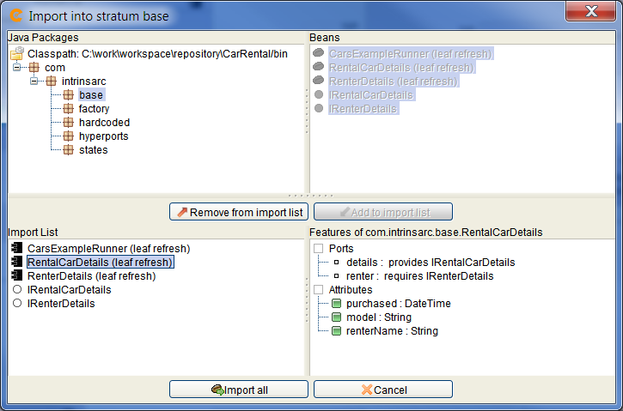
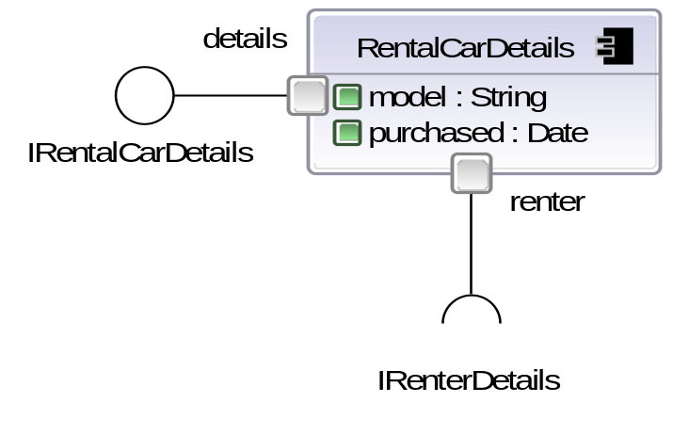
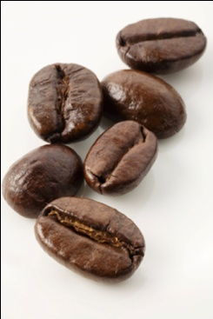
Importing beans as components
RentalCarDetails.java
Notes:
Works really well with standard JavaBeans.
We can think of evolve as a better way to join up beans!

Slide 19
Running an Evolve application
OR
Generate backbone &
run in BB interpreter...
Generate Java wiring code
Notes:
Backbone interpreter is <350kb – analogous to spring bean factory
In both cases, hierarchy is flattened into connected leaf instances.

Slide 20
Other features
Scales to very large models
  Diagrams are updated lazily
  Lessons learnt from UML tools
  Uses Eclipse UML2/EMF metamodel
Support top-down and bottom-up design approach
  Tolerant of errors in design phase
Team edition
  Multiple developers working on same model concurrently
  Advanced object database
Notes:
Some lessons learnt from UML tools
Scalable browser
Lazily updated diagrams
Undo/redo mechanism pushed into infrastructure

Slide 21
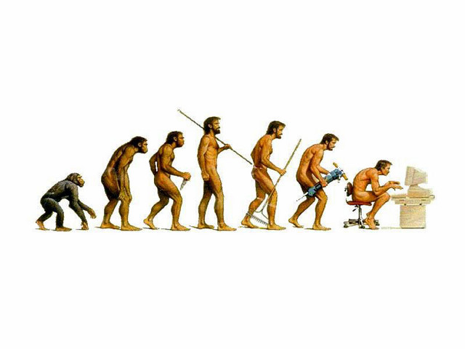

Capabilities and challenges

Slide 22
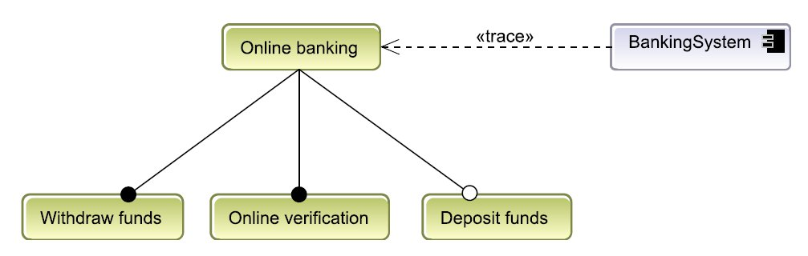
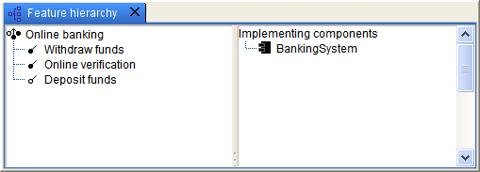
Extensible feature diagrams
Used to define requirements
  Product line technique
  Resemblance and replacement to extend feature graph
Notes:
This is very close to being finished
More of a requirements tool at the moment
Have traceability to components supporting features
In future cross-check between features chosen and features supported by components

Slide 23
Extensible protocols & goals
Based on behavior protocols for components [PV02]
  Aim: allow extension to enforce semantic guarantees
Sequence diagram, ports are actors
  Currently convert to labeled transition system
  Analyse via LTSA [MK06]
  Find a way to allow extension to “extend”
  Automatically assemble sequence diagram of composites
Notes:
Protocols describe behaviour, provide an upper bound
Sequence for composites automatically assembled
Then check using goals stated for extension and base – possibly tied to features
- Input and output traces at a high level?

Slide 24
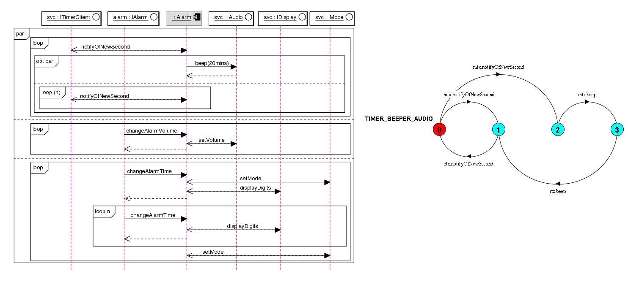
Extensible protocols (2)
Notes:
Mention that UML2 has far richer sequence diagrams.
We use a subset for describing protocols – gives bound of behaviour

Slide 25
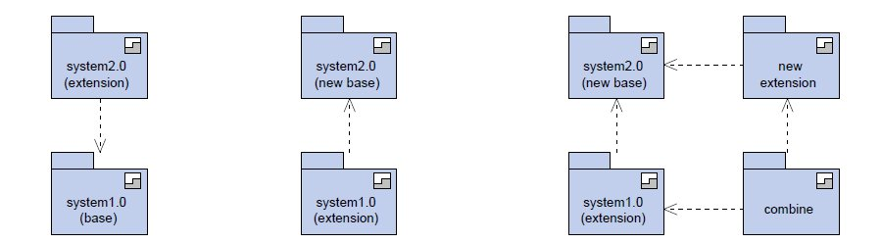
Backwards compatibility
Reverse dependencies
  Compresses deltas
  Older systems are now deltas against newer system
Notes:
Cost of older system is proportional to age
Can do cool things like bring a new extension back into an old version, and correct any structural issues!

Slide 26

Replacement for plugin architecture
Best of both worlds...
User
Developer
application
Notes:
+ user perspective: have a gui to download new extensions
+ developer perspective: have full evolve modeling environment to check/make new extensions
-- a bit like eclipse rcp
+ licensing features

Slide 27
Some other areas...
Reengineering a legacy application
  Actually easier than it looks
Active components for concurrency
  ROOM actor model? [SGW94]
Apply to different environments
  Android
  C#? C++?
  Hierarchical grid workflows

Slide 28
References
Jac02
Jackson, D.
Alloy: A Lightweight Object Modelling Notation
ACM Transactions on Software Engineering and Methodology (TOSEM), ACM Press, 2002, 11, 256-290
Rum96
Rumbaugh, J.
OMT Insights: Perspectives on Modeling
Journal of Object-Oriented Programming, Cambridge University Press, 1996, 123
MDEK9
Magee, J.; Dulay, N.; Eisenbach, S. & Kramer, J.
Specifying Distributed Software Architectures
Esec, 1995, 989, 137-153
MK06
Concurrency (State Models and Java Programs)
Magee, J. & Kramer, J.
John Wiley and Sons Ltd, 2006
PV02
Behavior Protocols for Software Components
Plasil, F. & Visnovsky, S.
IEEE Transactions on Software Engineering, IEEE Press, 2002
SGW94
Real-Time Object-Oriented Modeling
Selic, B.; Gullekson, G. & Ward, P.
John Wiley & Sons, 1994

